Slide 1
Repair App
BW Repair Management Application
PLANNING
IDEA
STRATEGY
FINANCE
MARKETING
http://13.126.170.121/

Slide 2
Technologies
Mysql
01
02
TypeScript
The database of the application is used by Mysql.
Bussiness logic is developed in TypeScript languages under Nodejs frameowork.
Angular 10
04
03
Node
Front end is developed by Angular 10 with Bootstrap and material design
Backend coding is in Nodejs framework

Slide 3
User module
User can raise a repair request for his Electronic devices like Phone , AC and Remotes etc using the application. This helps user to avoid standing in the shops. User can also order parts for different devices by using the same application.
Immediate
Repair request can sent immdiatly without a any type of waiting.
User friendly
User can choose the products and faults from the drop down.
Orders
User can order the parts for different devices as well as repair them too.

Slide 4
Technition module
Technition recive the repair request and send a price to the customer after validating the data sent by user.
Alerts
User will get alerts for each process
Add products
Adding products and parts for users selection
Reports
Signed in techniitian can see Daily reports and monthly reports .

Slide 5
Admin module
Admin can get the monthly and daily reports for all the technitians and monitor thier intractions with users.
Alerts
Technitians can recive admin alerts
Add products
Adding products and parts for users selection
Reports
All kind of reports can be seen.

Slide 6
Funtions
Order parts
SERVICES
Contact
Alerts
Profile
History

Slide 7
Flow chart

Slide 8
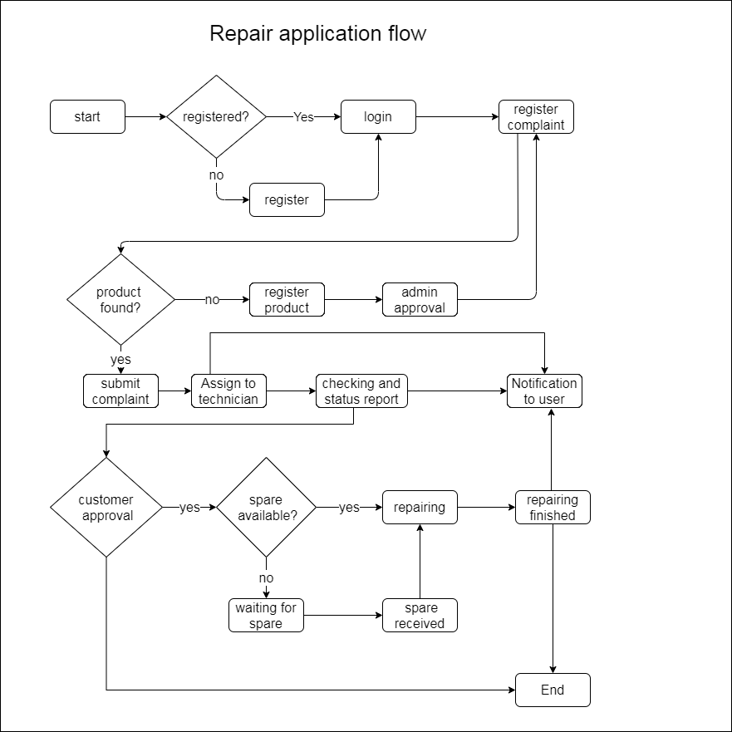

Slide 9
Database Design
User module

Slide 10
Users_table
User_id | INTEGER PK
Email | VARCHAR(255)
username | VARCHAR(255)
passwordHash | VARCHAR(255)
title | VARCHAR(25)
firstName | VARCHAR(255)
lastName | VARCHAR(255)
acceptTerms | TINYINT(1)
role | VARCHAR(255)
usersPhoto | VARCHAR(255)
userAddress | VARCHAR(255)
userPhone | VARCHAR(255)
userDOB | DATETIME
userStatus | VARCHAR(25)
verificationToken | VARCHAR(255)
verified | DATETIME
socialProvider | VARCHAR(255)
RefreshTokens
refreshId | INTEGER PK
token | VARCHAR(255)
expires | DATETIME
created | DATETIME
createdByIp | VARCHAR(25)
revoked | DATETIME
revokedByIp | VARCHAR(255)
replacedByToken | VARCHAR(255)
usersTableUsersId | INTEGER fk
Users_table | (continues)
socialUserId | VARCHAR(255)
resetToken | VARCHAR(255)
resetTokenExpires | DATETIME
passwordReset | DATETIME
created | DATETIME
updated | DATETIME
Social_users_table
socialUserId | INTEGER PK
socialUserProviderId | VARCHAR(255)
email | VARCHAR(255)
socialUserName | VARCHAR(255)
socialUsersPhoto | VARCHAR(25)
firstName | VARCHAR(255)
lastName | VARCHAR(255)
authToken | TEXT

Slide 11
Products_table
Products_id | Int PK
Products_name | text
Products_added_time | date
Products_photo | text
Color_id | Int FK
Material_id | Int FK
Brand_id | Int FK
User_id | Int FK
Models_id | Int FK
Discounts_id | Int FK
Category_tree_table
Category_id | Int PK
Category_name | varchar(45)
Category_icon | text
Category_added_time | date
Category_parent | Int
Connections_table
Connections__id | Int PK
Product_id | Int FK
Category_id | Int FK

Slide 12
Models_table
Models_id | Int PK
Models_name | text
Models_added_time | date
Brand_id | Int FK
Material_table
Material_id | Int PK
Material_name | varchar(45)
Material_added_time | date
Brand_table
Brand_id | Int PK
Brand_name | varchar(45)
Brand_added_time | date
Faults_table
Faults_id | Int PK
Faults_name | text
Faults_added_time | date
Product_id | Int FK
Color_table
Color_id | Int PK
Color_name | varchar(45)
Color_added_time | date

Slide 13
Enquirers_table
Enquirers_id | Int PK
Enquirers_data | text
Enquirers_added_time | date
User_id | Int FK
Complaints_table
Complaints_id | Int PK
Complaints_details | text
Complaints_added_time | date
Complaints_attachments | text
User_id | Int FK
Product_id | Int FK
Faults | Int FK
Discounts_table
Discounts_id | Int PK
Discounts_name | text
Discounts_percentage | double
Discounts_amount | double
Discounts_added_time | date
Product_id | Int FK

Slide 14
Charge_table
Charge_id | Int PK
Charge_price | text
Charge_added_time | date
Discounts_id | varchar(45)
Product_id | Int FK
Complaint_id | Int FK
Fault_id | Int FK
User_id | Int FK
Status_table
Status_id | Int PK
Status_data | text
Status_added_time | date
Product_id | Int FK
Complaint_id | Int FK
Fault_id | Int FK
User_id | Int FK
Charge_id | Int FK

